Slide 1
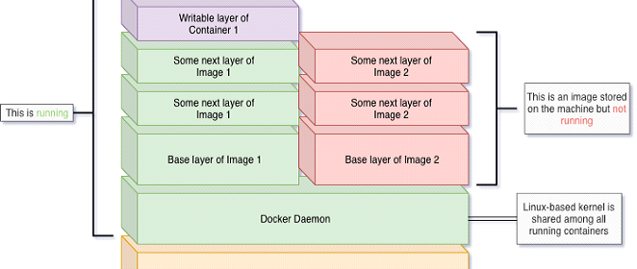
Docker images and Containers

Slide 2
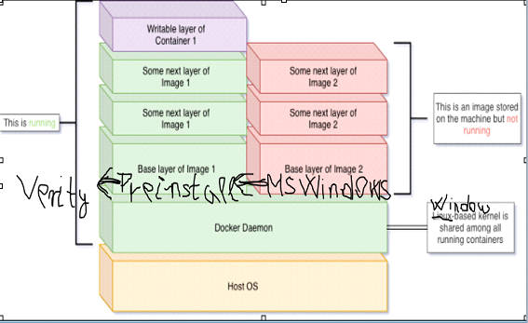
Stories
CD-36157 – Finalize Docker image of pre-installations
A Docker image including all software needed to run Verity according to the "CD Newcomer Installation PDF“
CD-34819 – Compose Verity image
A Docker image based on the above image including the "Verity SEM 10" app installed and setup for Start.

Slide 3
Demo
1. Verity SEM 10 at state "Tool is Ready" installed and setup by QA scripts in development environment (VM)
2. Demo Docker scalability for running tests using the Verity image:
Run several Verity images in parallel to see how it is scaling up.
3. Simulate running a regression test with the Verity container using external data files.
Run a script that returns Success or Failure by comparing input vs expected output.

